Slide 1


AI CodeBooster
This document provides a brief documentation on results

Slide 2
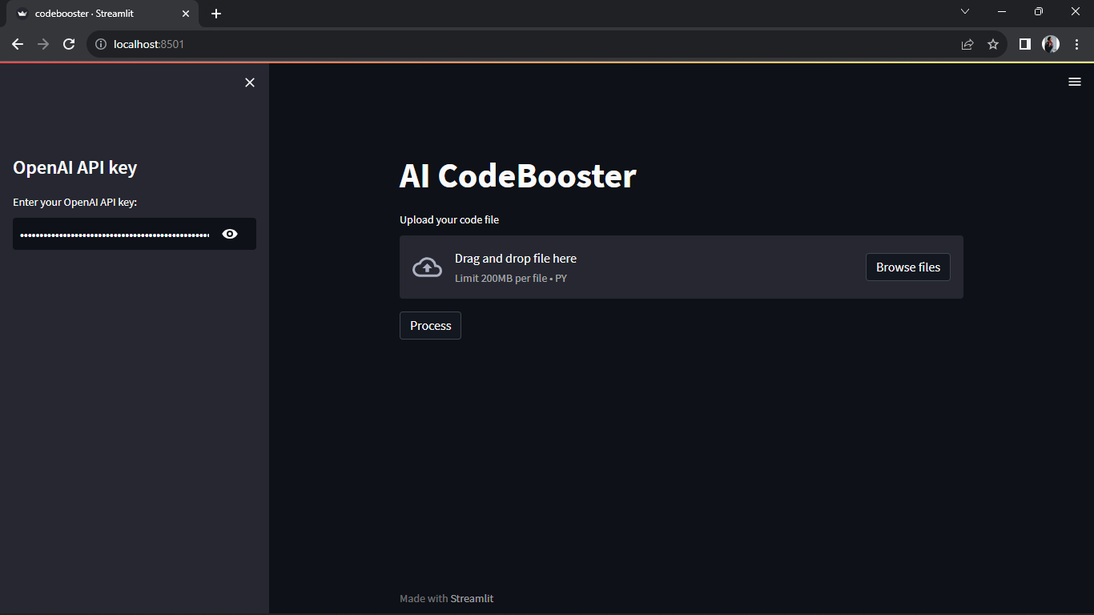
UI of AI Codebooster in google crome

Slide 3
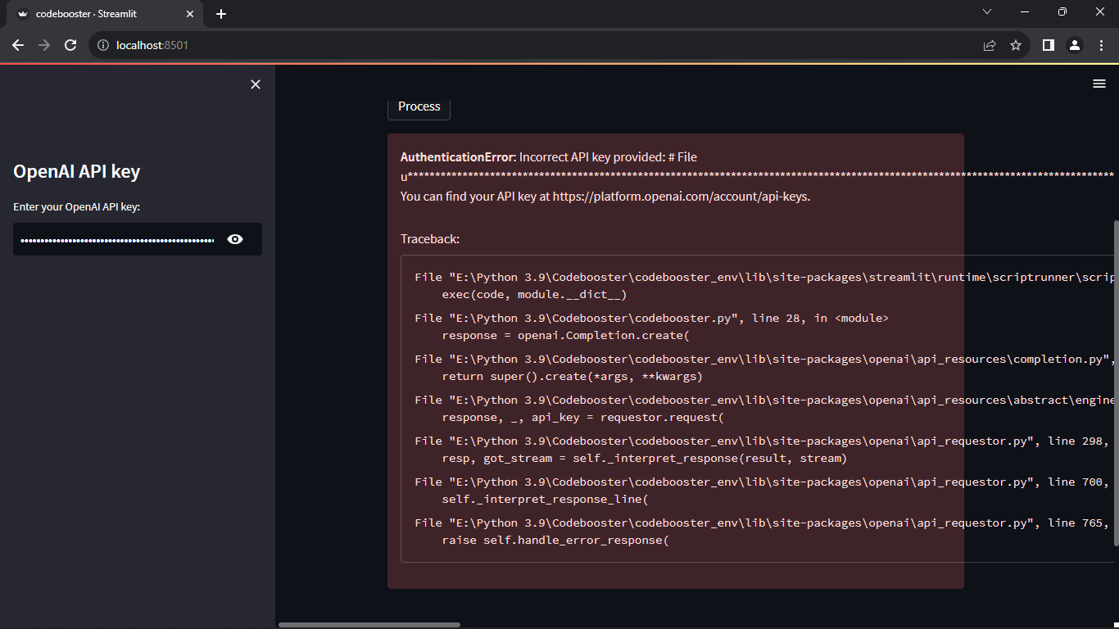
When entered incorrect or expired API key.

Slide 4
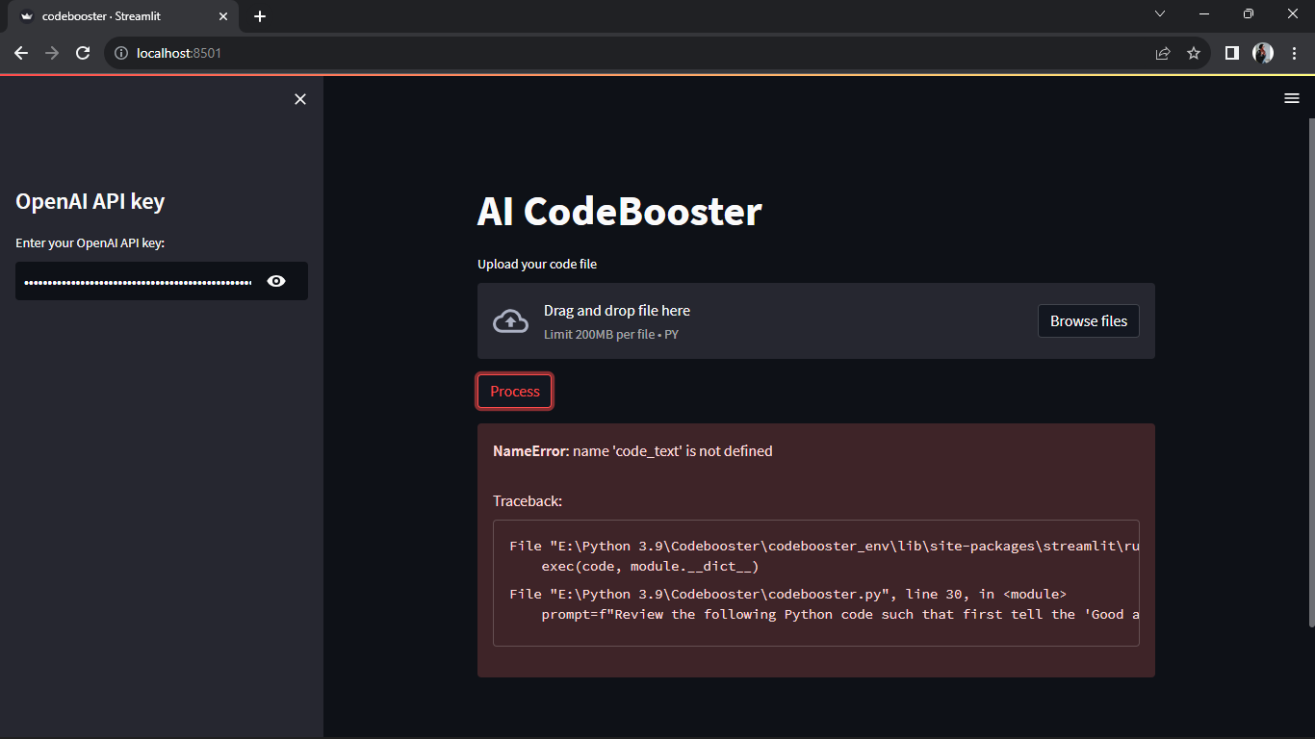
When we click “Process” button without uploading a file, we get this error.

Slide 5
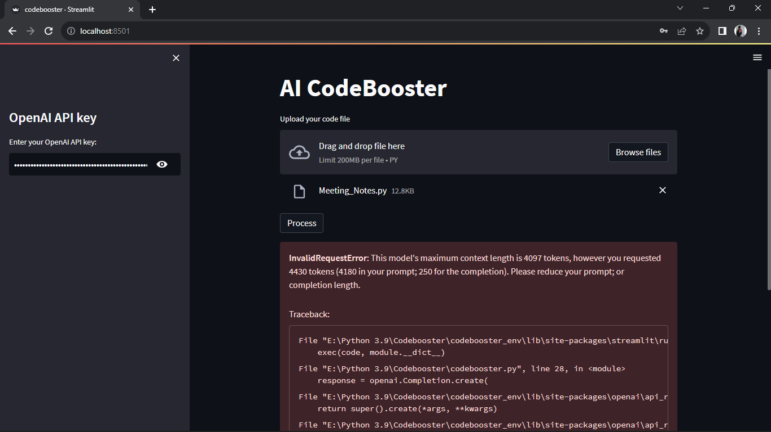
When the content length is more than the given token completion length.

Slide 6
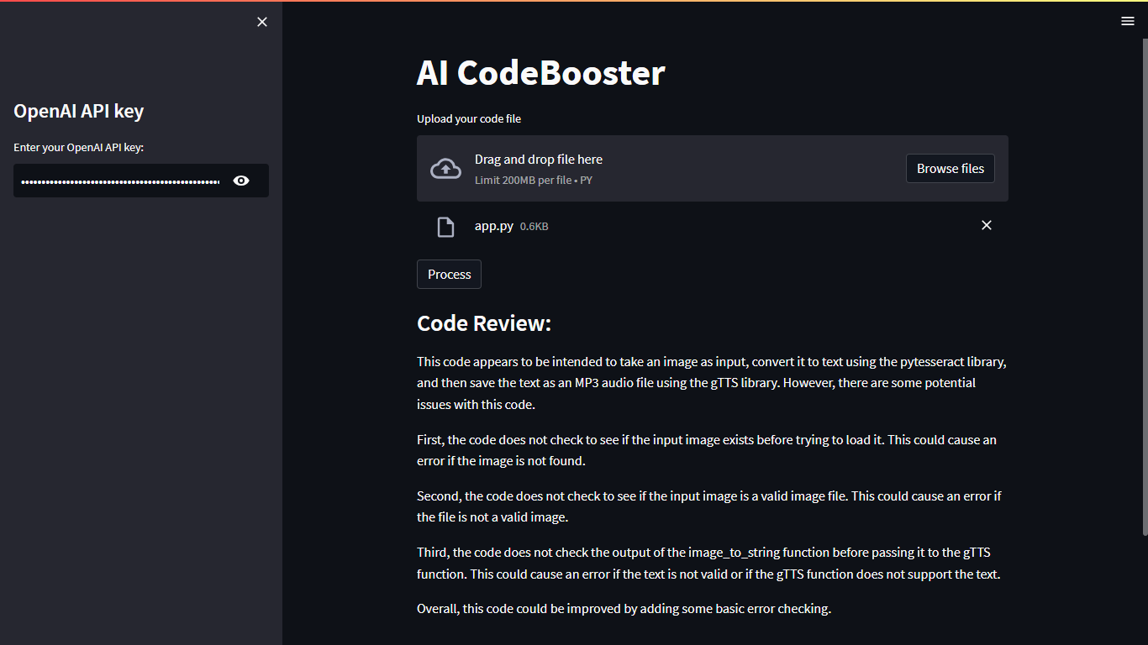

Slide 7
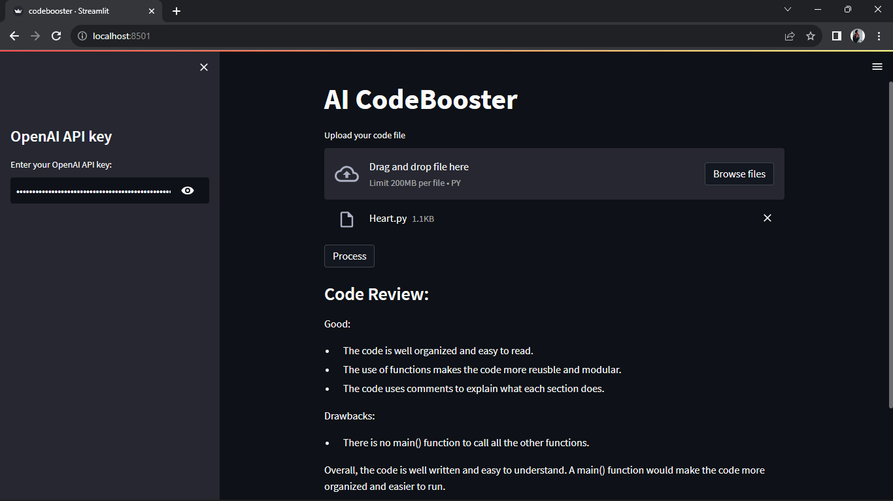

Slide 8
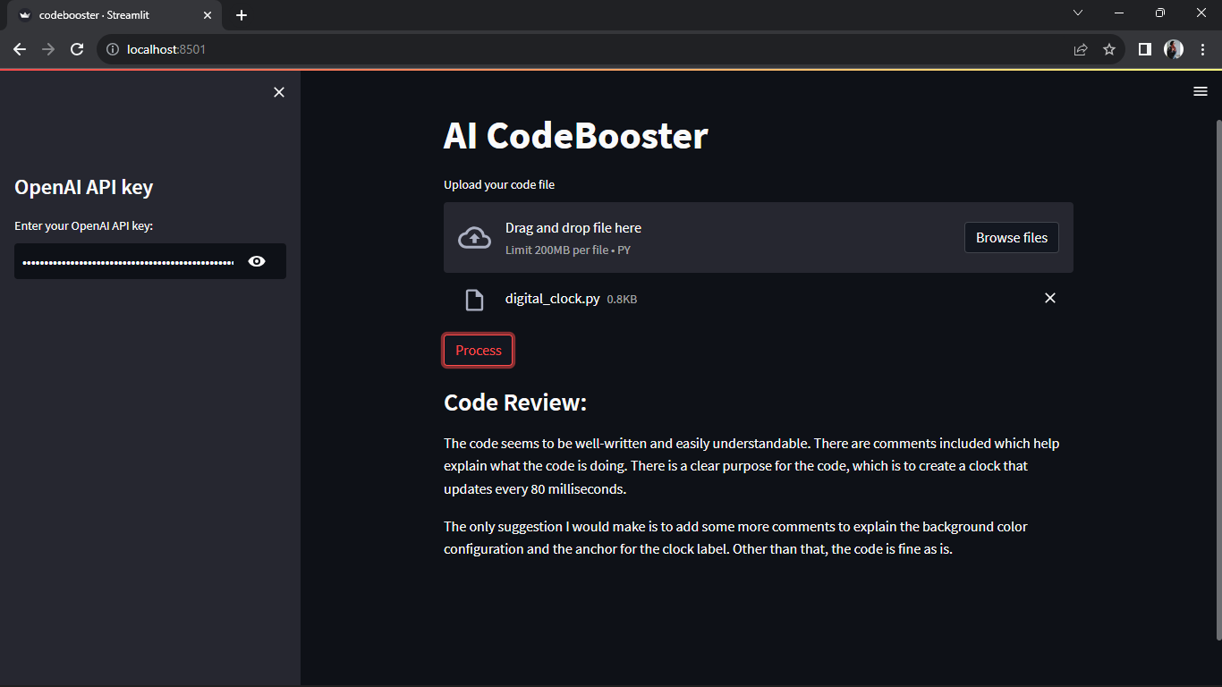

Slide 9
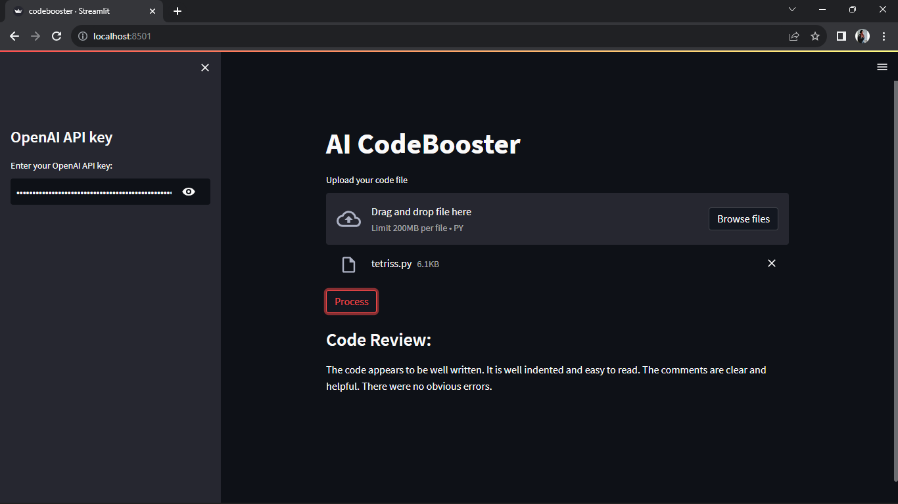

Slide 10
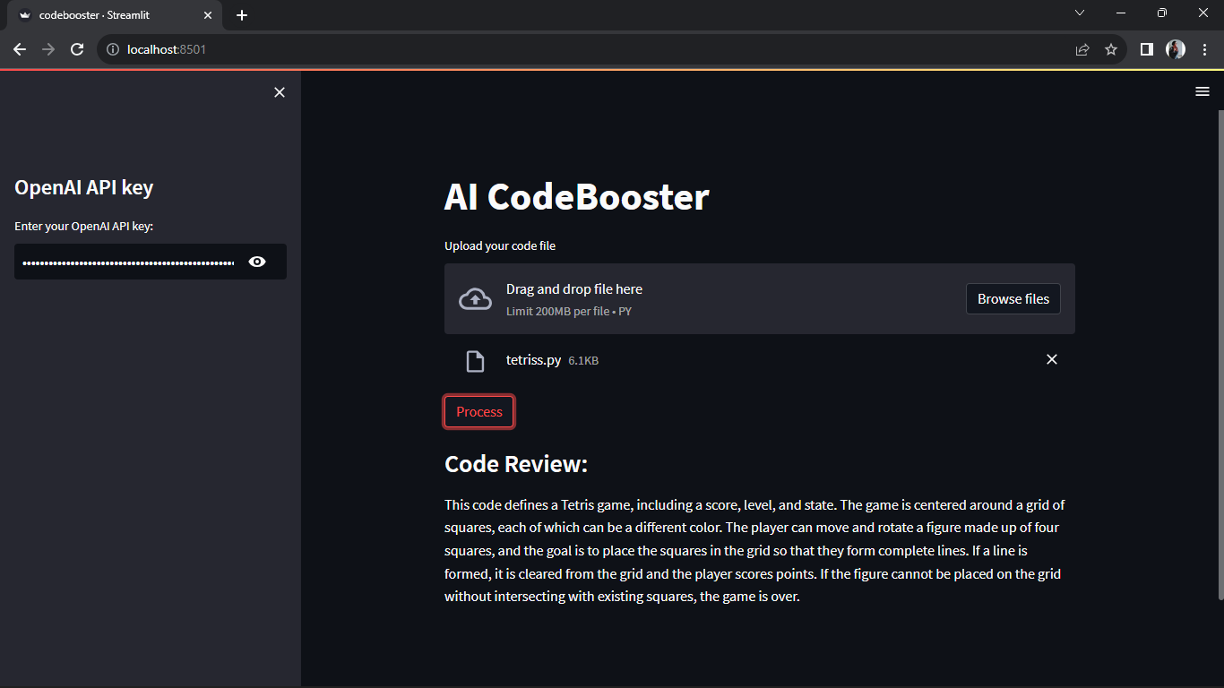

Slide 11
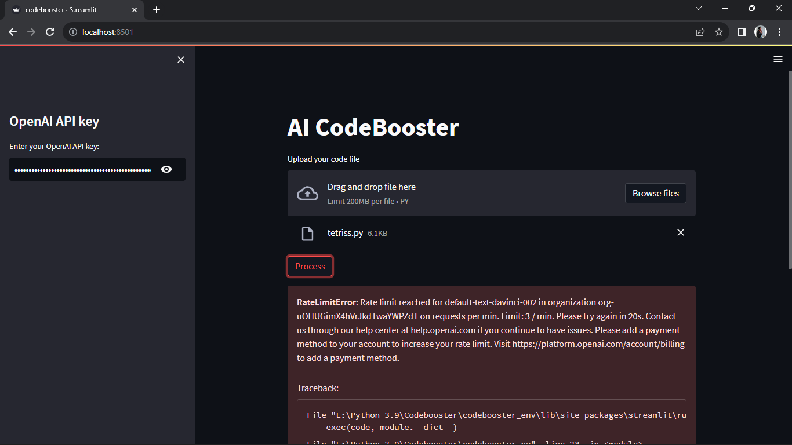
When we click “Process” button more than 3 times, it shows a limit error.

Slide 12
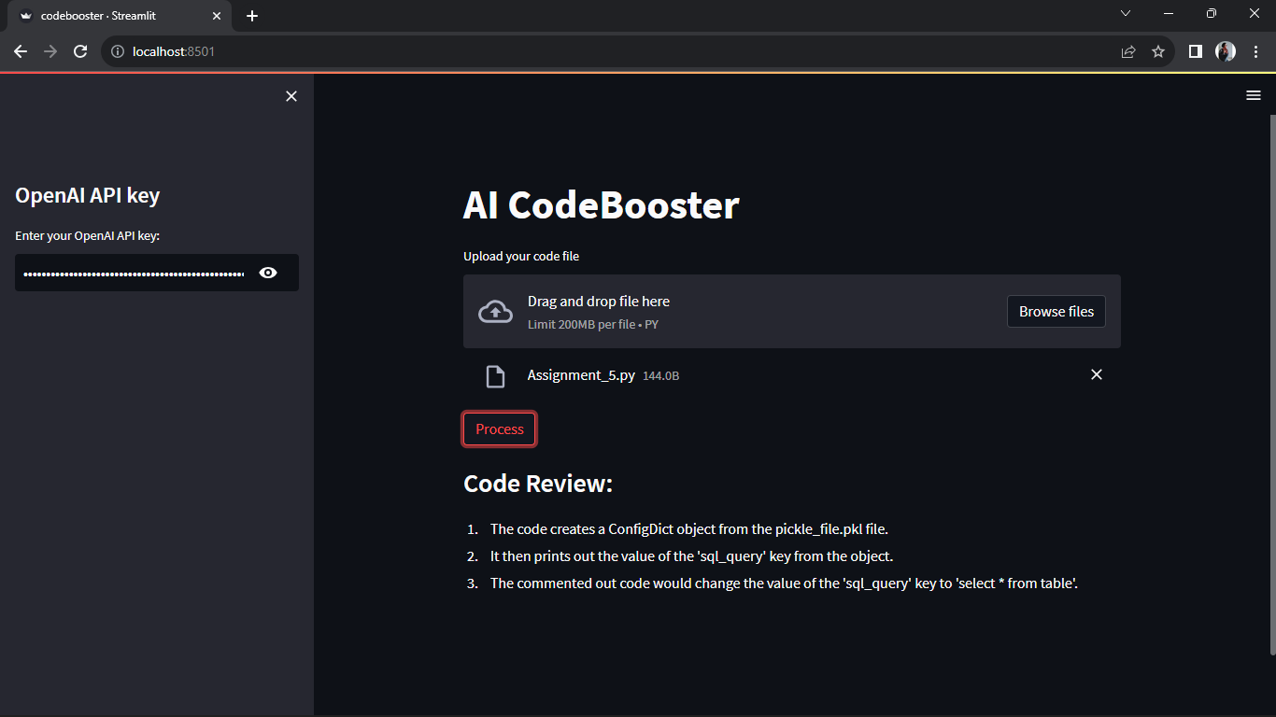

Slide 13
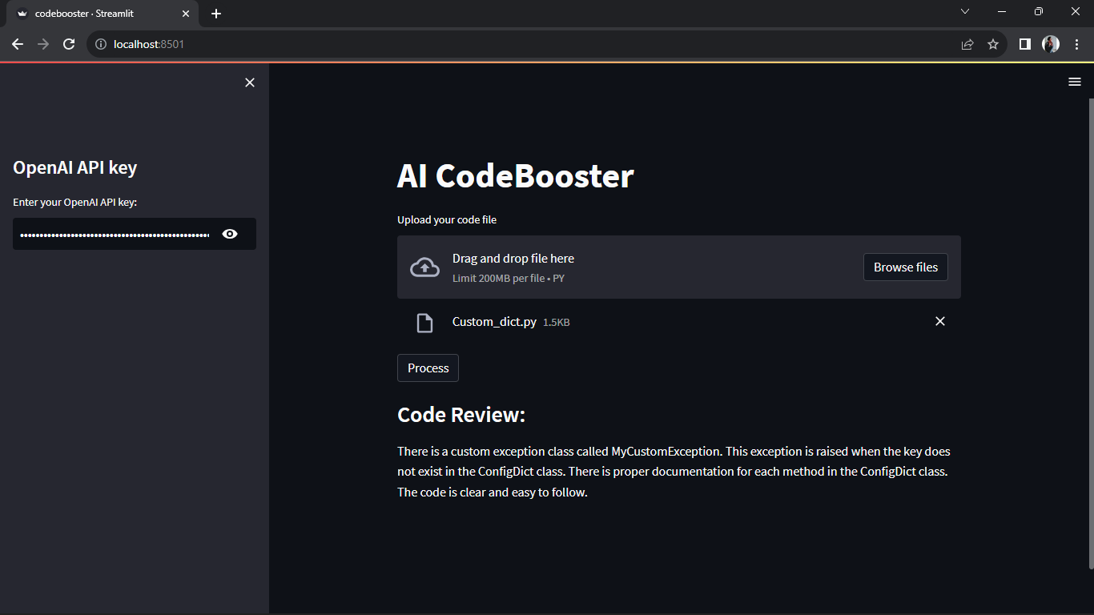

Slide 14
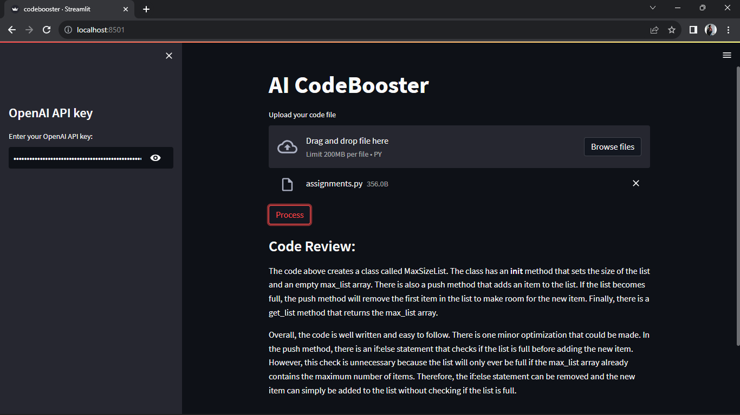

Slide 15
